Slide 1

DATA
ANALYST
PROJECT
Turning Data Into Insights
Project Name :- Cafe Sales Data Analysis
----> Exploratory Data Analysis(EDA) using Python
Pandas • NumPy • Matplotlib • Seaborn
Presented by: Jyoti Biradar
jyotibiradar3266@gmail.com

Slide 2

Project Objective :-
Understanding cafe sales patterns and generating useful business insights
  Clean and prepare transaction-level cafe sales data.
  Explore categorical and numerical variables using EDA.
  Analyze product, payment method, location, and monthly sales patterns.
  Study relationships between Quantity, Price Per Unit, and Total Spent.
  Present findings that can support data-driven business decisions.

Slide 3

Import all the libraries
Numpy
Pandas
Matplotlib
Seaborn
import numpy as np
import pandas as pd
import matplotlib.pyplot as plt
import seaborn as sns

Slide 4
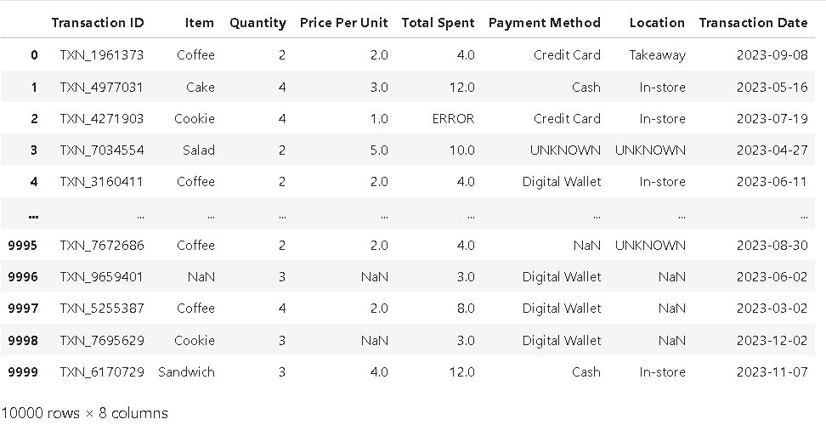
Upload the DataSet:-
pd.read_csv("dirty_cafe_sales.csv")

Slide 5
Dataset Overview :-
Column Description:-
  Transaction ID :- A unique identifier for each transaction.
  Item :- The name of the item purchased.
  Quantity :- The quantity of the item purchased.
  Price Per Unit :- The price of a single unit of the item.
  Total Spent :- The total amount spent on the transaction.
  Payment Method:- The method of payment used.
  Location :- The location where the transaction occurred.
  Transaction Date :- The date of the transaction.

Slide 6
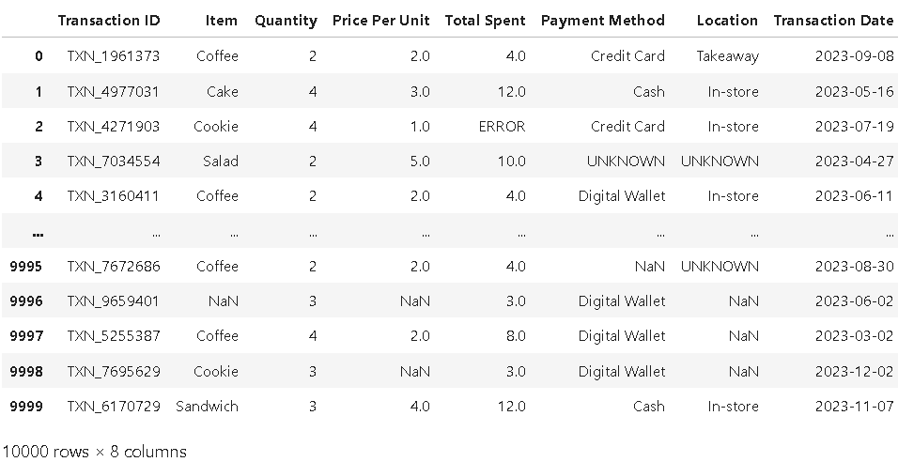
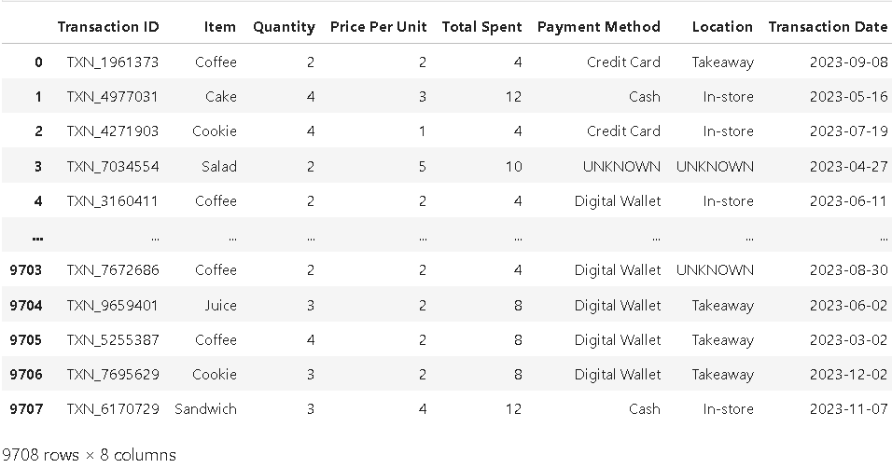
⟶ Before Cleaning Dataset
⟶ After Cleaning Dataset

Slide 7
Quick Dataset Verification:-
df.head()
  shows top 5 rows by default
df.tail()
  shows bottom 5 rows by default
df.shape
  it return (number of rows, number of columns).
df.info()
  it gives summary of a Dataset.
df.describe()
  it gives statistical summary for numerical columns.
df.isnull().sum()
  finding total count of null values in a dataset.
df['Transaction ID'].is_unique
  to check the unique values.
df['Transaction ID'].duplicated().sum()
  to check the duplicate values.
df.dtypes
  find the data type of each column
df.columns
  it returns columns names.
df.select_dtypes(include="object").columns.tolist()
  to check the categorical column data.
df.select_dtypes(include="number").columns.tolist()
  to check the numerical column data.
df["Transaction Date"] = pd.to_datetime(df["Transaction Date"],errors="coerce")
  Convert valid dates and invalid values to NaT

Slide 8
EDA(Exploratory Data Analysis):-
---> EDA stands for Exploratory Data Analysis. It is the process of understanding a dataset using data cleaning, statistics, and visualization.
Common EDA techniques:
  Data cleaning : - Removing or correcting missing, duplicate, and incorrect data.
  Missing-value analysis :- Identifying and handling missing values in the dataset.
  Univariate analysis:- Analyzing one variable at a time to understand its distribution.
  Bivariate analysis:- Analyzing the relationship between two variables.
  Multivariate analysis:- Analyzing relationships among three or more variables.
  Correlation analysis:- Measuring the strength and direction of relationships between numerical variables.
  Data Visualization: Using charts and graphs to understand patterns and trends in the data.

Slide 9
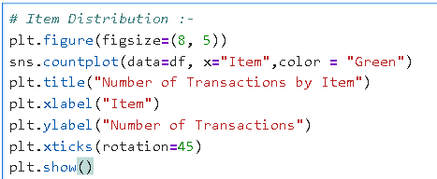
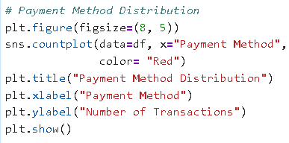
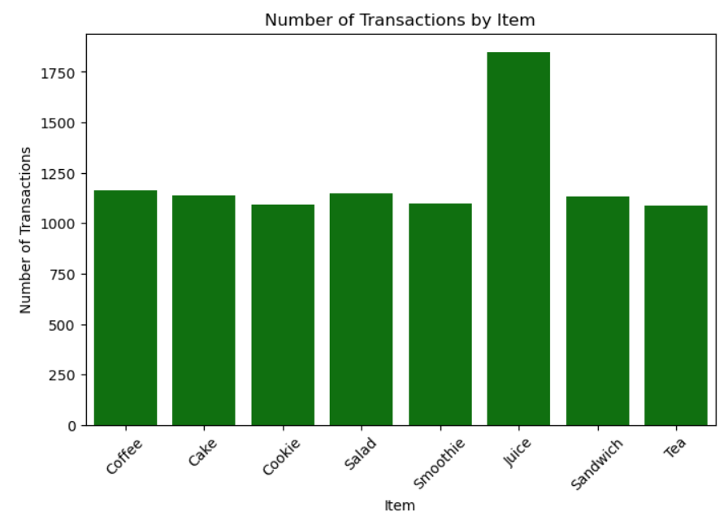
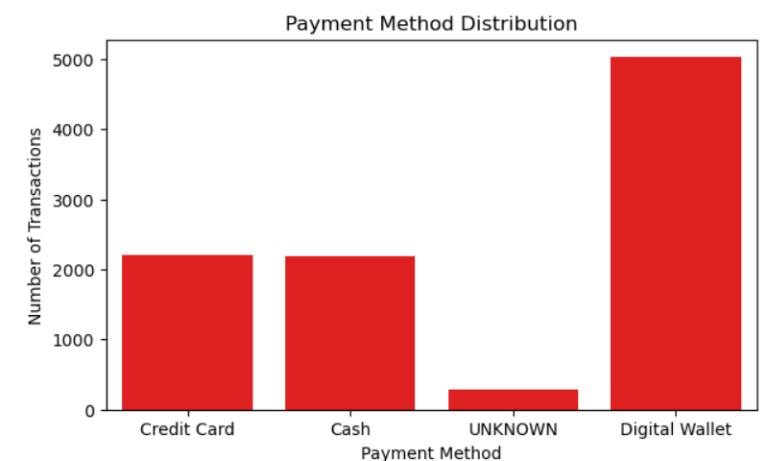
Univariate Analysis:-
- analyzing one column at a time.
---> it shows the Number of Transactions by Item
---> it shows the Number of Transactions by Payment Method

Slide 10
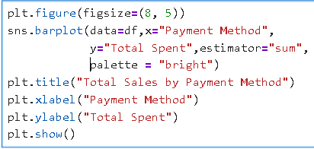
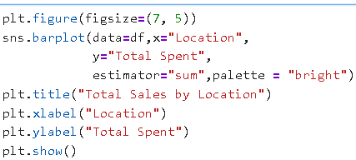
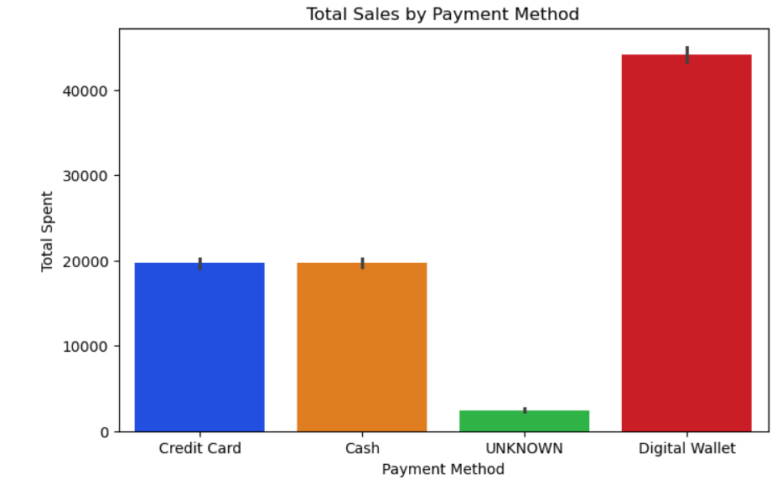
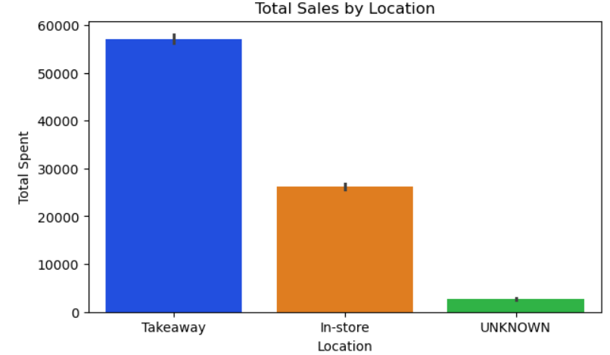
Bivariate Analysis:-
- it is the relationship between two variables(two Columns).
---> This plot shows which payment method generates the highest total sales.
---> This plot shows which Location generates the highest total sales.

Slide 11
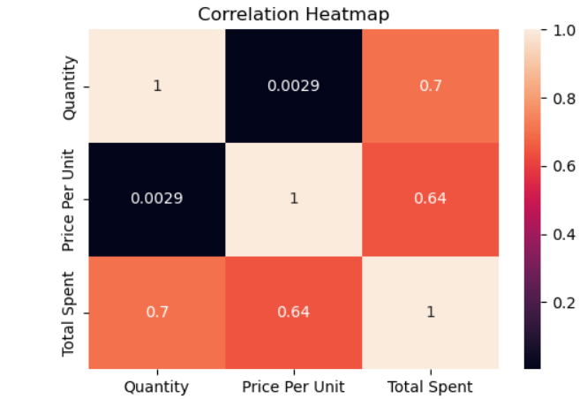
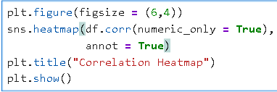
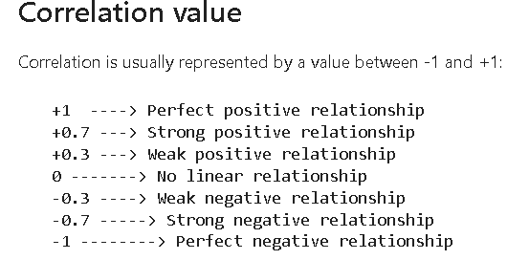
Multivariate analysis :-
- To analyse more than two variables
Correlation Matrix/Analysis :-
    Correlation analysis is a technique used in EDA to understand the relationship between two or more numerical variables.
## Correlation Heatmap: - A heatmap makes this easier to understand:

Slide 12
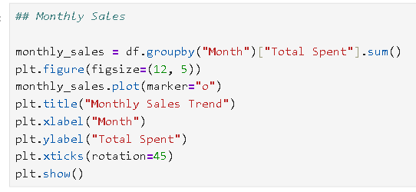
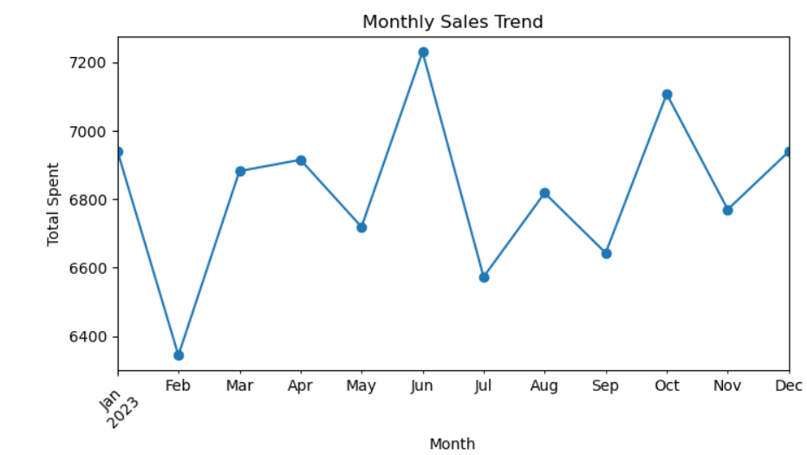
Monthly Sales:-
  Total recorded sales by month.
---> Highest monthly sales:
2023-06 with 7,230.
---> Lowest monthly sales:
2023-02 with 6,344.

Slide 13
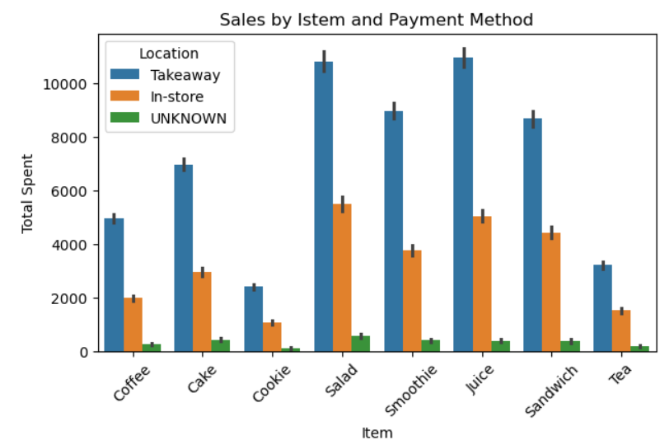
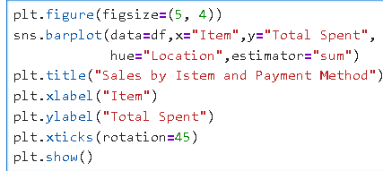
Sales by Item and Location:-
  It helps us understand which items generate the most sales and which location customers use most.
Cafe DataSet Insights:-
  Juice has the highest number of transactions.
  Digital Wallet is the most frequently used payment method.
  Monthly sales show an increasing/decreasing trend.
  Takeaway transactions are more common than In-store transactions.
Thank
you!

